Slide 1


Better glass.
Better comfort.
LoĒ‑180 • LoĒ²‑272 • LoĒ³‑366 • Neat+
Double pane • Triple pane • Argon • Super Spacer®
A contemporary guide for confident window selection
Technical values are center-of-glass unless noted.

Slide 2
START WITH THE CLIMATE GOAL
The coating controls solar heat—not just heat loss
Choose the solar-gain strategy first; then choose pane count, argon fill and Super Spacer®.
COLDEST / PASSIVE SOLAR
BALANCED / FOUR SEASONS
HOT SUN / FADE CONTROL
LoĒ‑180
LoĒ²‑272
LoĒ³‑366
Welcomes winter sun
Moderates summer heat
Rejects more solar heat
High solar gain • no Neat+
Neat+ included free
Neat+ included free
SHGC 0.69
SHGC 0.41
SHGC 0.27
All comparison values: 3 mm double-pane IGU, 13 mm cavity, 90% argon. Product-specific configurations can vary.
Sources: Cardinal CG09–12/24; LoĒ product pages
02

Slide 3
HOW IT WORKS
A microscopic coating redirects invisible heat
Low-emissivity layers remain transparent to daylight while reflecting long-wave infrared energy.
The coating surface position matters
LoĒ coating
SUN
#2 surface
Typical LoĒ²‑272 / LoĒ³‑366 placement
Silver + metal-oxide layers
are sputter-deposited and nearly invisible.
#3 surface
LoĒ‑180 passive-solar placement
HEAT
#1 exterior
Neat+ surface on our 272 and 366 packages
Important: coating selection changes SHGC, visible light and UV transmission. Pane count and gas fill primarily change insulation.
Sources: Cardinal LoĒ‑180, LoĒ²‑272 and LoĒ³‑366 product literature
03

Slide 4
VERIFIED COMPARISON
Three coatings, three distinct comfort strategies
Lower U-factor reduces heat flow. Lower SHGC reduces solar heat gain. Higher VT admits more daylight.
Product / best fit
Visible light
SHGC
U-factor
UV trans.
LoĒ‑180 | no Neat+
79%
0.69
0.26
29%
LoĒ²‑272 | Neat+ free
72%
0.41
0.25
16%
LoĒ³‑366 | Neat+ free
65%
0.27
0.24
5%
Apples-to-apples basis
3 mm glass • 13 mm airspace • 90% argon • center-of-glass values. Whole-window ratings depend on frame, size, Super Spacer profile and configuration.
Source: Cardinal Technical Service Bulletin CG09–12/24 (Dec. 2024)
04

Slide 5
PRODUCT PROFILES
Choose the solar response that fits the elevation
Orientation, shading, climate and room use should influence coating selection.
180
High solar gain
NO NEAT+
Winter heat can be an asset
Brightest of our three Low‑E choices
South-facing cold-climate rooms
272
Balanced control
NEAT+ FREE
Cuts solar gain to 0.41
Our versatile all-season package
Mixed orientations / all-season comfort
366
Maximum solar control
NEAT+ FREE
Only 5% UV transmission
Strongest fade control of our three
West / south exposure, cooling loads
Sources: Cardinal product pages and CG09–12/24
05

Slide 6
NEAT+ NATURALLY CLEANER GLASS
Included free with LoĒ²‑272
and LoĒ³‑366.
40%
25%
≈3×
less dust vs. uncoated glass
more photoactive than original Neat
faster drying after sufficient UV exposure
How it works
Our package rule
1 Conductive surface dissipates static charge
2 Sunlight activates TiO₂ photocatalysis
3 Hydrophilic surface lets water sheet and dry faster
LoĒ‑180 is supplied without Neat+. LoĒ²‑272 and LoĒ³‑366 always include Neat+ at no additional charge. Neat+ does not change visible light, SHGC or thermal performance.
Sources: Cardinal Neat+ product page, brochure and TSB CG04–06/24
06

Slide 7
PANE COUNT
Triple pane adds another insulated cavity—and more design leverage
The glass package must still be evaluated as part of the complete window.
DOUBLE INSULATED GLASS
TRIPLE INSULATED GLASS
2 panes • 1 argon cavity
3 panes • 2 argon cavities
Standard sealed unit
Optional high-performance unit
Overall thickness: 7/8 in.
Overall thickness: 1 3/8 in.
Cardinal LoĒ glass + Super Spacer®
Cardinal LoĒ glass + Super Spacer®
Example: LoĒ³‑366 + Neat+ / clear / LoĒ‑180 triple pane with 90% argon reaches center-of-glass U-factor 0.13.
Configuration: manufacturer-provided IGU specification; performance example: Cardinal LoĒ³‑366 brochure
07

Slide 8
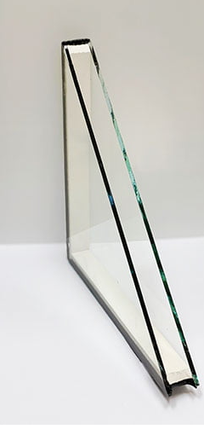
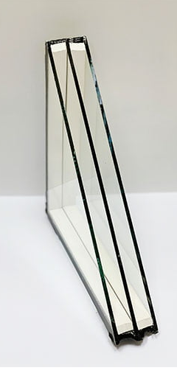
OUR SEALED GLASS UNITS
Built in-house around a proven component stack
1
Cardinal LoĒ glass
Controls solar gain, daylight and UV
2
Super Spacer®
Flexible, no-metal warm-edge system
3
Argon gas
Reduces heat transfer in each cavity
4
Integrated desiccant
Helps manage moisture inside the unit
5
Secondary sealant
Supports gas retention and structural durability
6
In-house fabrication
Controls assembly, fill and finished quality
Photographs show representative double- and triple-pane constructions.
Product construction: manufacturer specification; Super Spacer source: Quanex
08

Slide 9
ARGON FILL
Argon lowers heat transfer when the cavity and seals are engineered together
Cardinal’s published LoĒ comparison values use a 90% argon / 10% air fill.
0.31 → 0.26
0.30 → 0.25
0.29 → 0.24
LoĒ‑180 U-factor: air → argon
LoĒ²‑272 U-factor: air → argon
LoĒ³‑366 U-factor: air → argon
What preserves the benefit
Optimized gap
Gas performance depends on cavity width.
Barrier system
Super Spacer layers help control moisture and gas loss.
Flexible edge
Foam construction moves with temperature cycling.
Quality fill control
Published Cardinal data assumes 90% initial fill.
Sources: Cardinal CG09–12/24; Quanex Super Spacer dual-seal product information
09

Slide 10
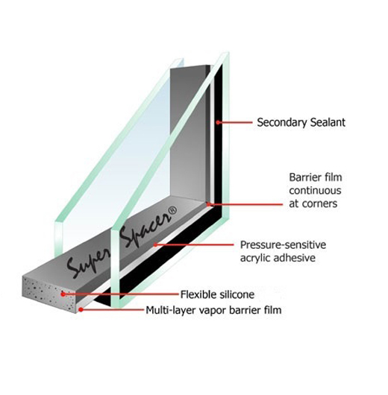
SUPER SPACER®
The flexible warm edge completes our insulated-glass package
Cardinal coated glass provides optical and solar performance; Super Spacer supports edge efficiency and durability.
FLEXIBLE • ALL-FOAM • NO METAL
Why we use it
Warmer glass edge
Reduces thermal transfer at the perimeter
Lower seal stress
Expands and contracts with temperature changes
Moisture control
Desiccated construction protects the cavity
Dual-seal design
Secondary sealant supports gas retention and strength
Clean sightline
A narrow, continuous edge appearance
Exact Super Spacer profile and secondary sealant follow our approved production specification.
Sources: Quanex Super Spacer dual-seal product page; manufacturer-provided construction diagram
10

Slide 11
OUR GLASS MENU
Three Low‑E packages—clearly defined
Tempered and laminated glass are also available for applicable safety, security and specialty requirements.
Package
Glass
Neat+
Availability / purpose
Passive-solar package
LoĒ‑180
Not included
High solar gain; double or triple pane
Balanced package
LoĒ²‑272
Included free
All-season control; double or triple pane
Solar-control package
LoĒ³‑366
Included free
Low SHGC and strong UV reduction
Tempered glass
Available
Per package rule
Safety glazing where required or specified
Laminated glass
Available
Per package rule
Safety, security, sound or specialty use
ER ratings are not provided for tempered or laminated sealed units. Published performance values elsewhere in this guide are center-of-glass data.
HTR Solutions product availability; Cardinal performance data
11

Slide 12
THE TAKEAWAY
Specify the glass package,
not just “Low‑E.”
1
Three Low‑E choices
2
Pane count
180, 272 or 366—no other Low‑E options
Double or triple insulated glass
3
Argon + Super Spacer
4
Neat+ rule
Protect thermal performance and edge durability
Free with 272 and 366; not offered on 180
Primary sources
cardinalcorp.com/products/coated-glass • quanex.com/product/insulating-glass-spacers/dual-seal
Technical bulletins: Cardinal CG09–12/24 and CG04–06/24 • Manufacturer IGU specification
Tempered and laminated options are available; ER ratings are not provided on those units.
Prepared from Cardinal Glass and Quanex primary sources • July 2026
12

